Slide 1
Health care system
INTCDB22DW063
Team 5

Slide 2
Team members
Deep Prasad 2121507
Radhika Chourasia 2117217
Avani Saraf 2116122
Anurag Singh 2122417
Manasi Dhengole 2135069
Ayush Yadav 2143918
Shriyans Dutta Gupta 2130274

Slide 3
Project idea
The primary objective of the project is to create a database with required data validations as mentioned. The database is in turn used for generating welcome letters in XML format for each subscriber.
The following are the modules in this proposed system:
-> Group
-> Sub Group
-> Subscriber

Slide 4
Technology used
SQL Server 2019 (Version 15.0)
SQL Server Management Studio (SSMS) (Version 18.3.1)
T-SQL
SQL Server Integration Services (SSIS) (Visual Studio 2019)
Microsoft PowerBI (Latest version 2.106. 582.0)

Slide 5
Steps
Queries in SSMS:
Creating the database “Health Care System”
Creating Target Group table
Creating Target Sub-Group table
Creating Target Subscriber table
Creating a Welcome letter XML file
SSIS:
Loading Group Tables
Loading Sub-Group Tables
Loading Subscriber Tables
Creating Welcome Letter XML file
Reporting Using PowerBI

Slide 6
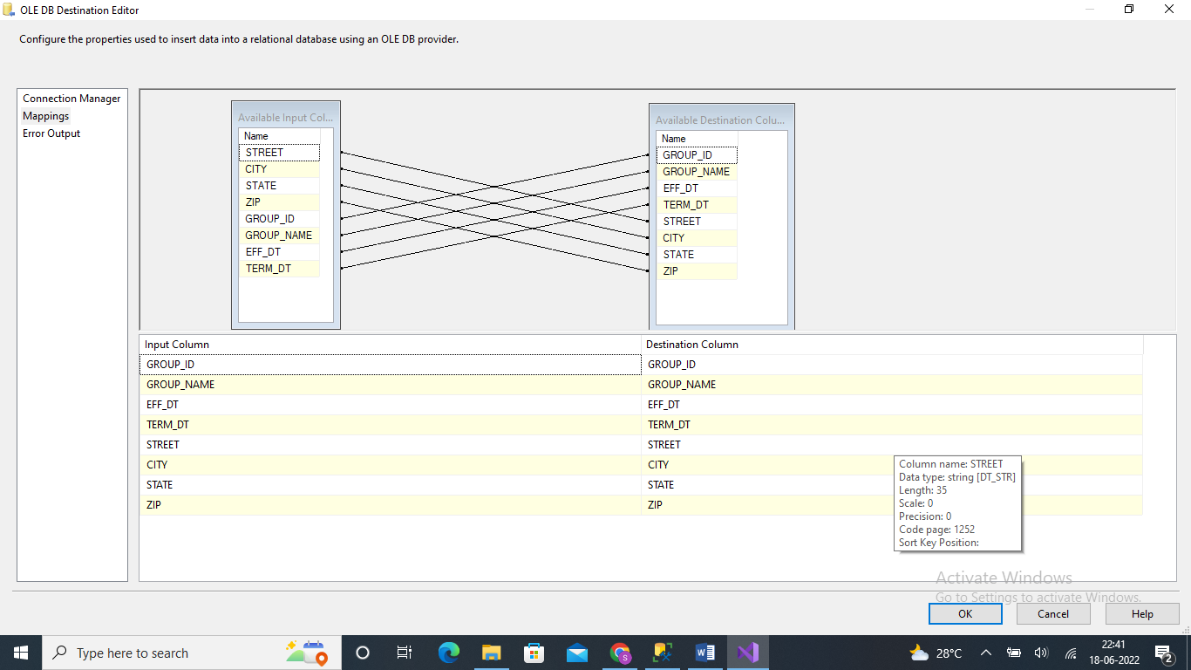
Screenshots
1. Loading Group tables
Mapping Of Data in the Group Table

Slide 7
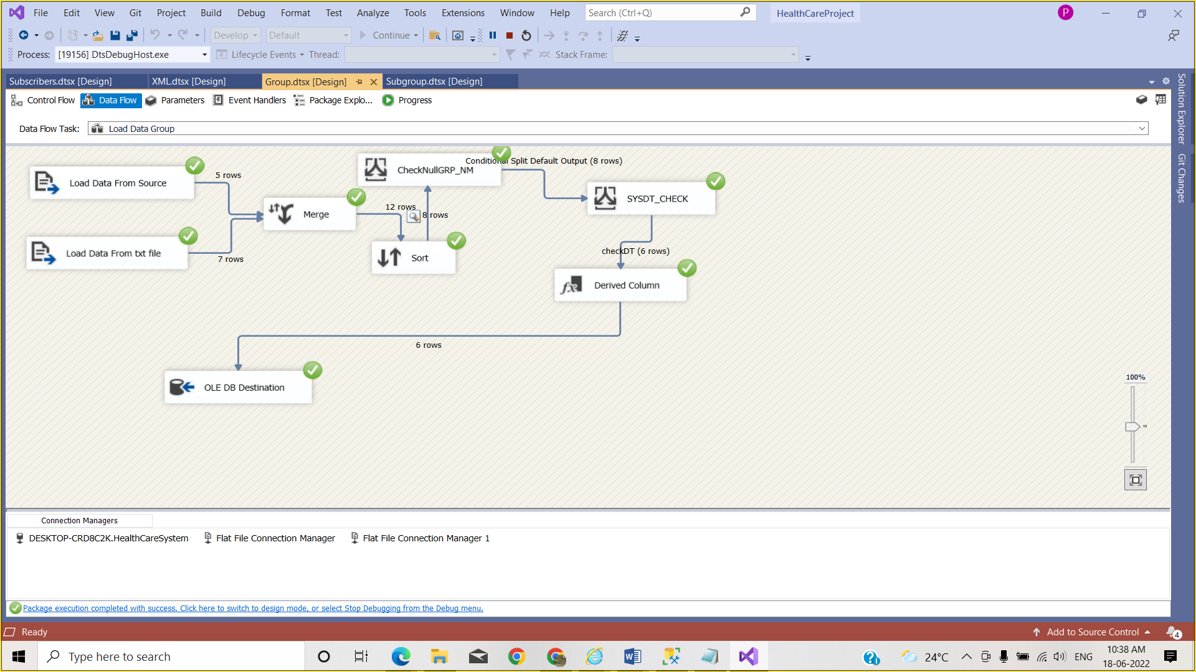
Successful Execution of loading data in Group Table.

Slide 8
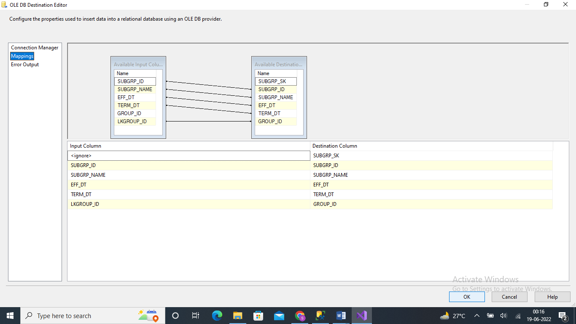
2. Loading Sub-Group Table
Mapping in the SUB-GROUP Table

Slide 9
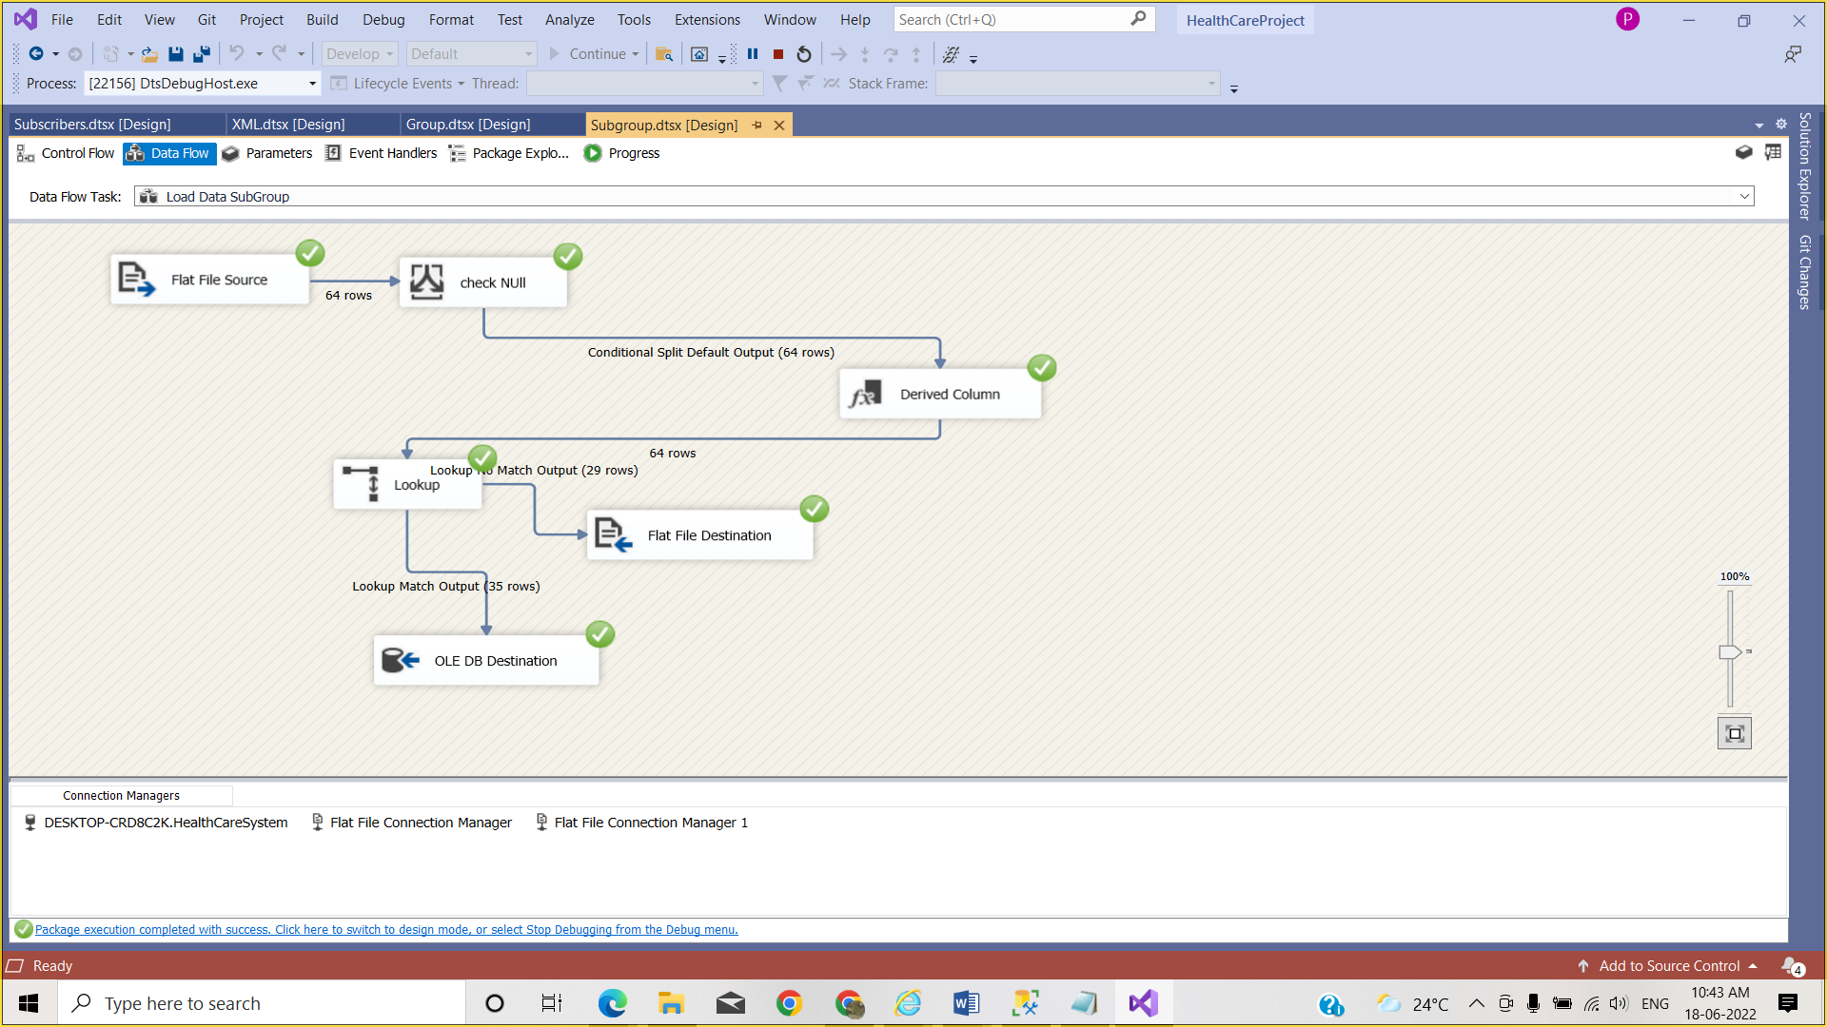
Successful execution of loading data in the target Subgroup table

Slide 10
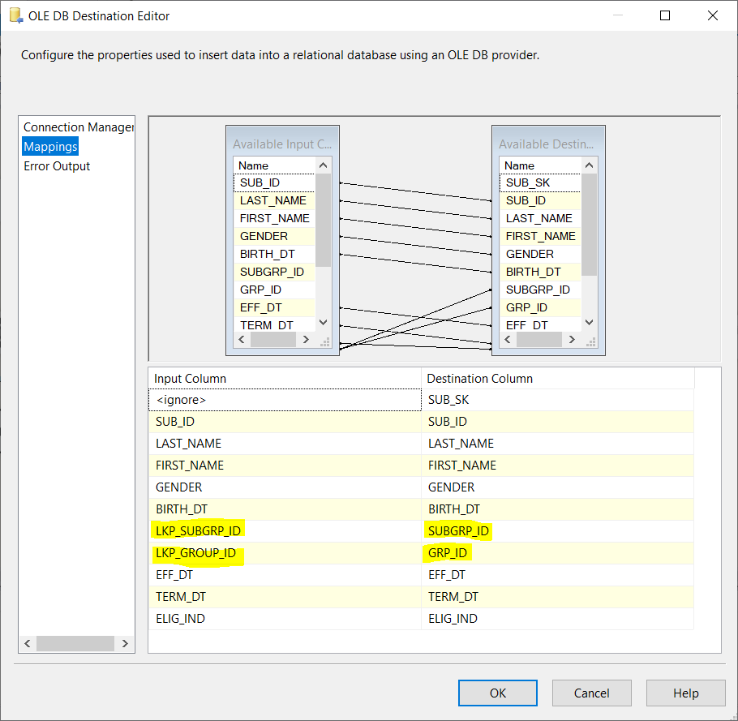
3. Loading Subscriber Tables
Mapping of Data in the Subscriber Table

Slide 11
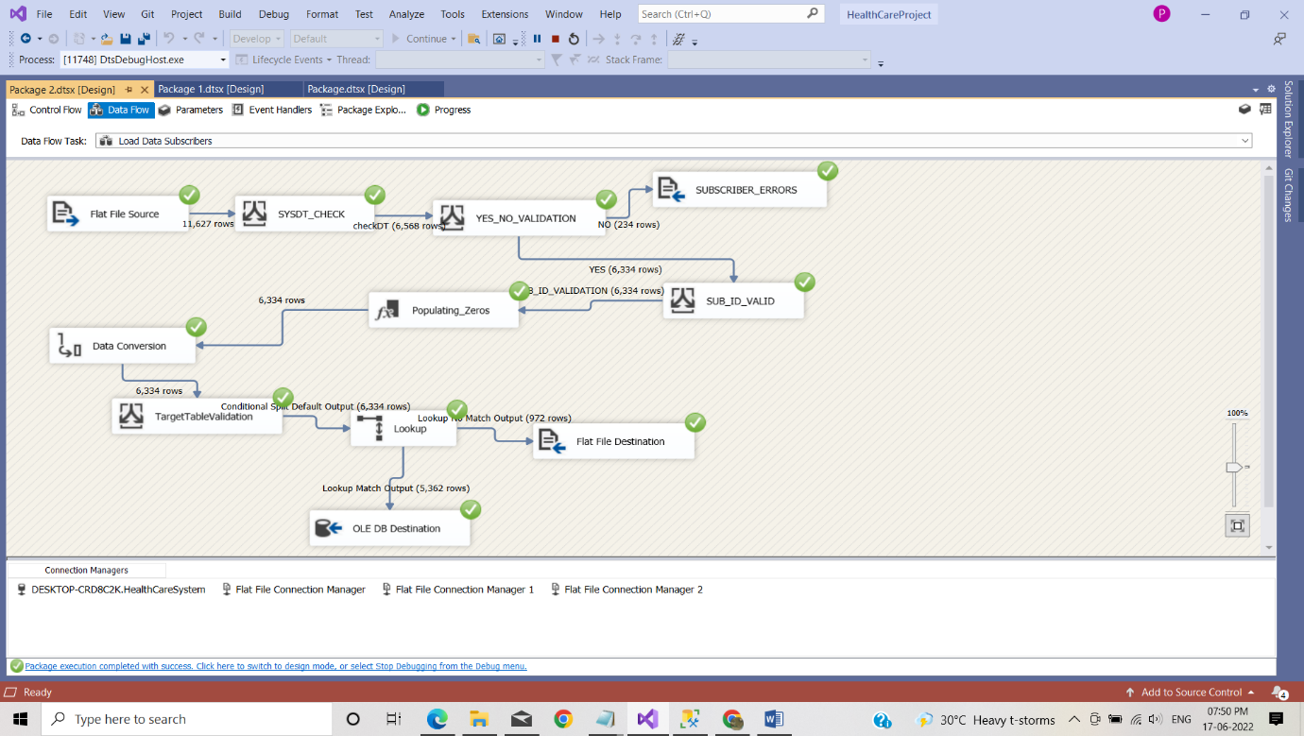
Successfully execution of loading data in the Subscriber table

Slide 12
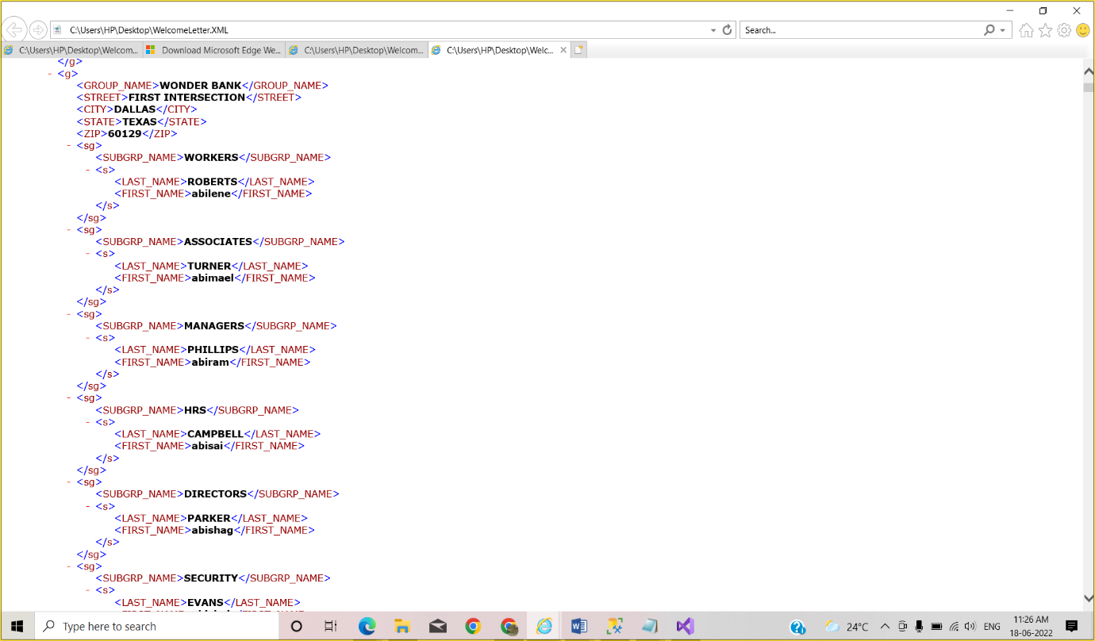
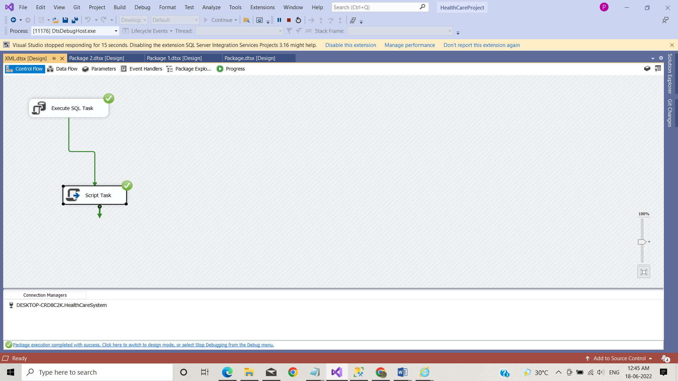
4. Creating Welcome Letter
Successfully Executing the Package for XML File
Welcome Letter XML FILE

Slide 13
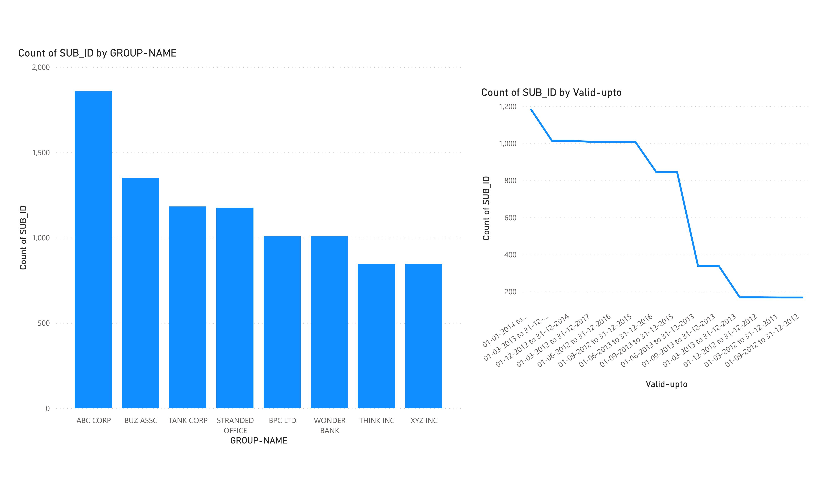
Power BI Report
Group-Subscriber Relationship

Slide 14
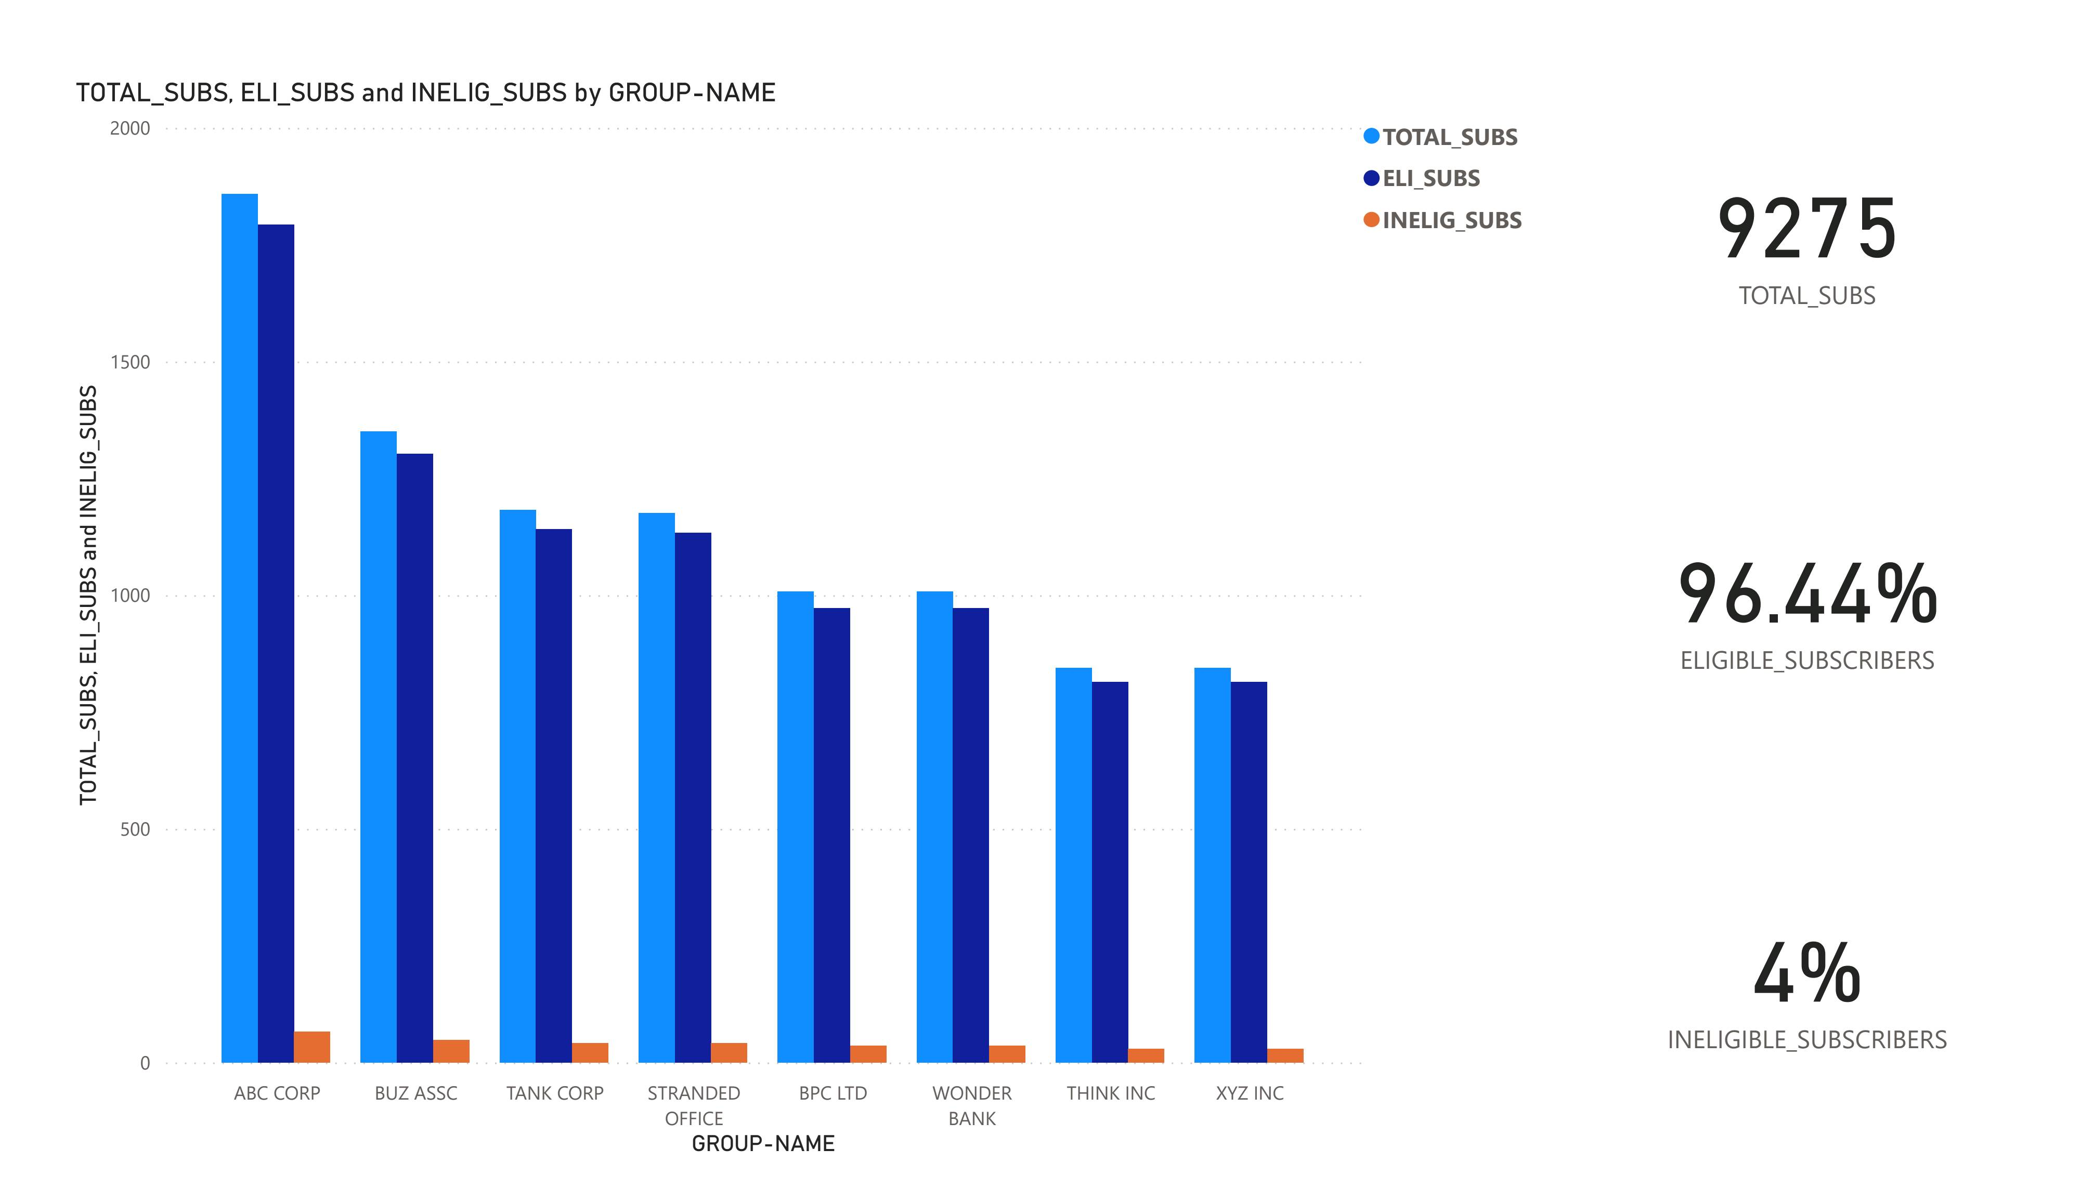
Ratio of Eligible & In-Eligible

Slide 15
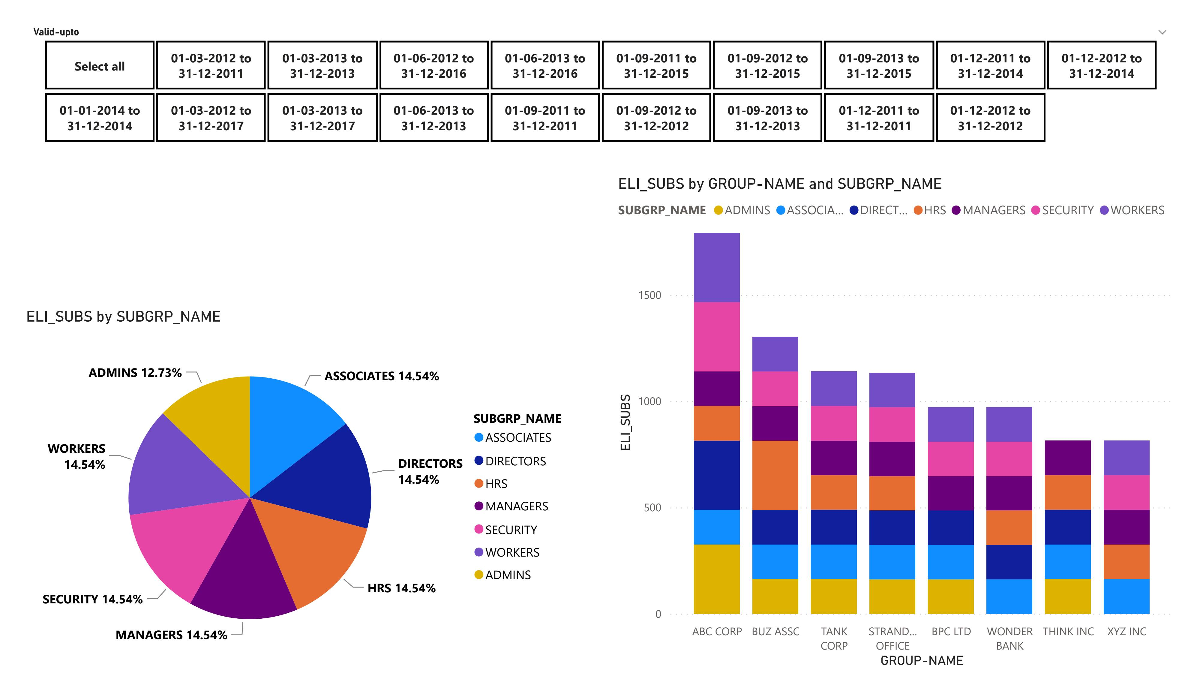
Group-Subgroup-Subscriber Relationship Analysis

Slide 16
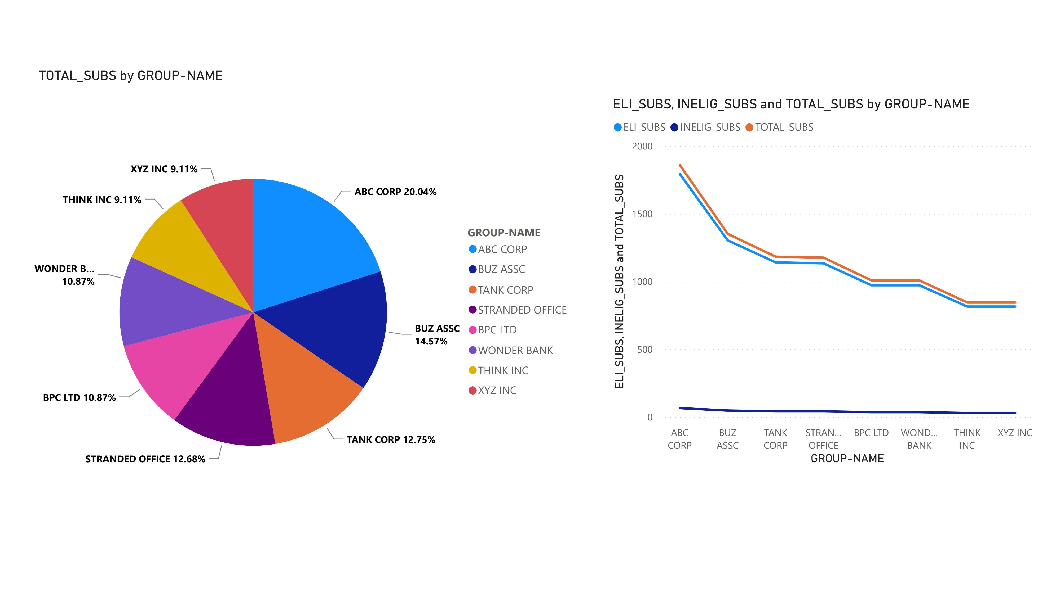
Detailed Analysis - 1

Slide 17
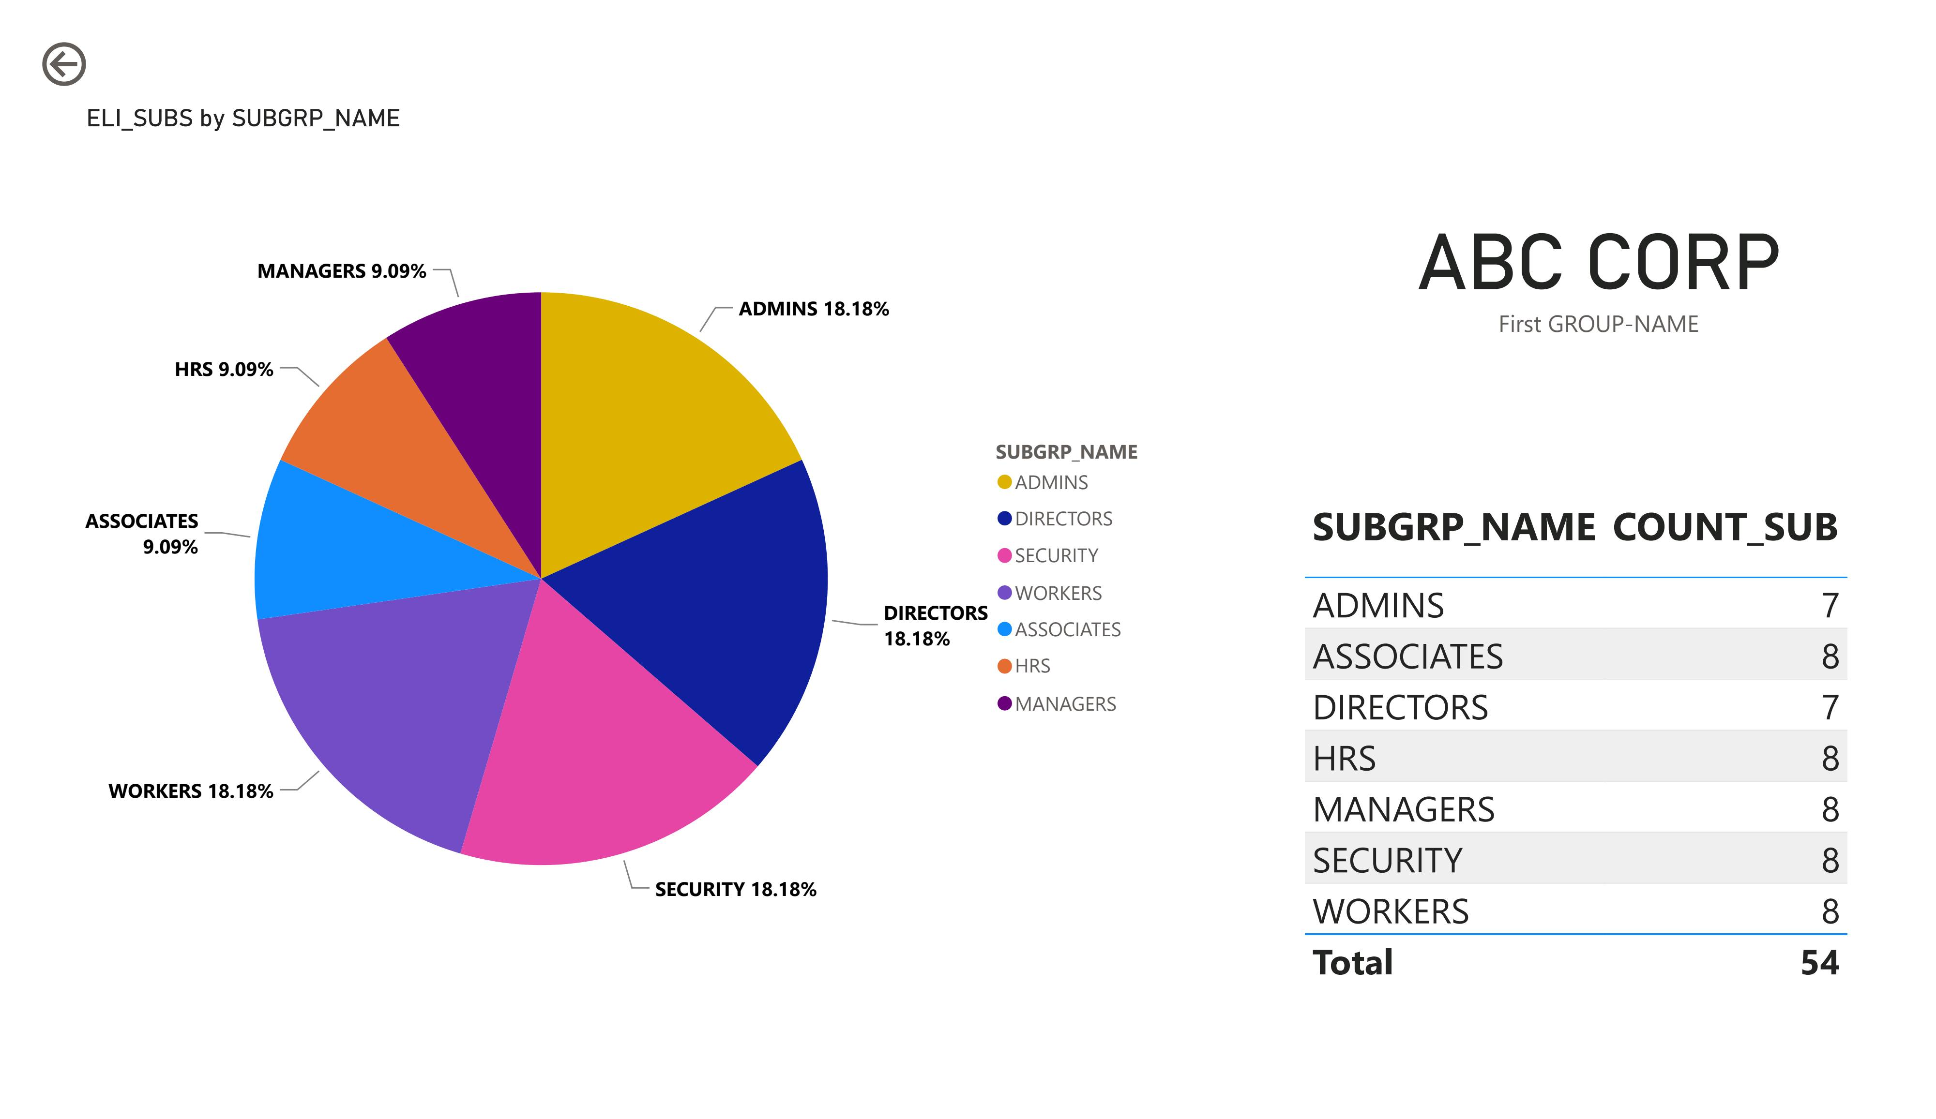
Detailed Analysis- 2

Slide 18
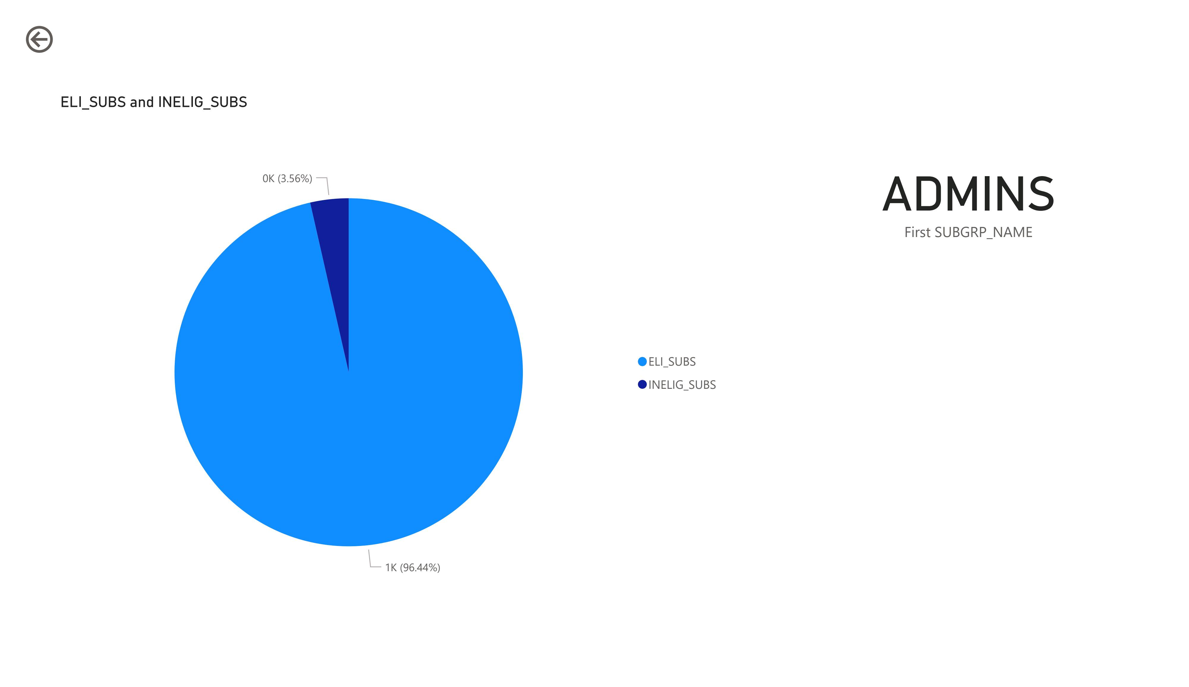
Detailed Analysis- 3

Slide 19
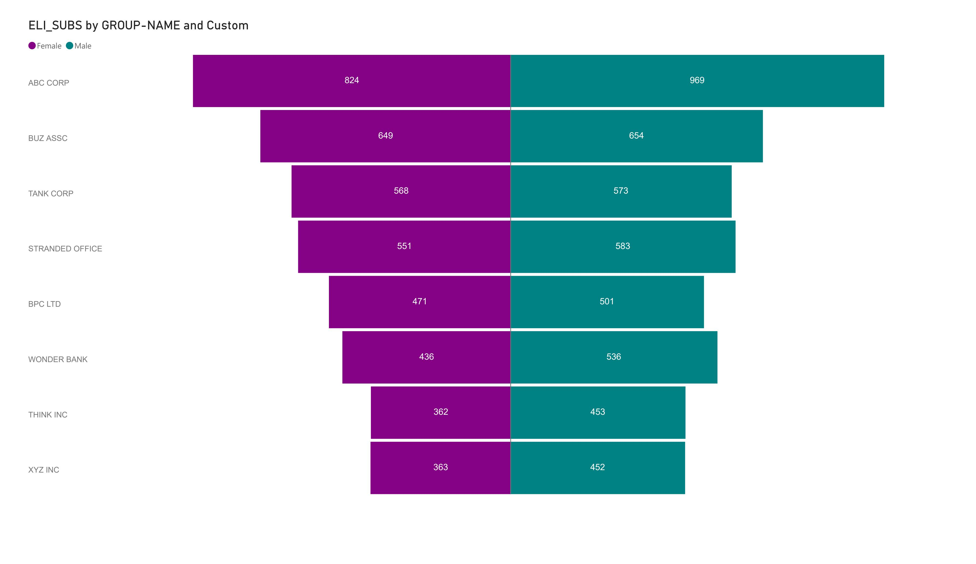
Group-Gender Comparison

Slide 20
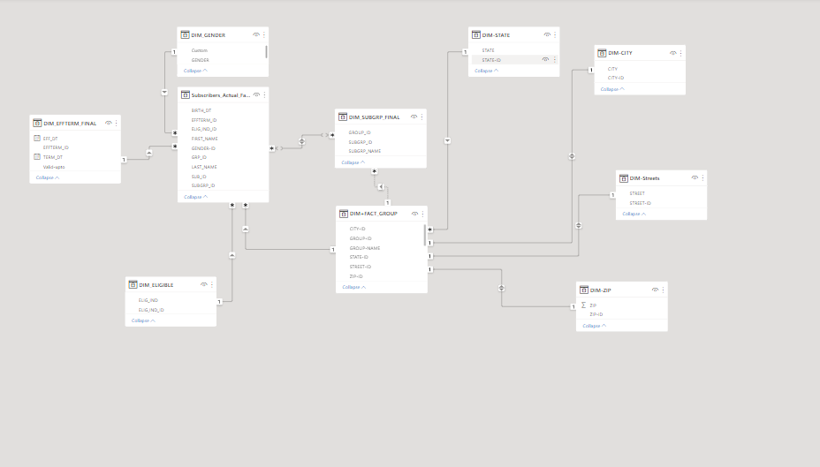
Relationships

Slide 21
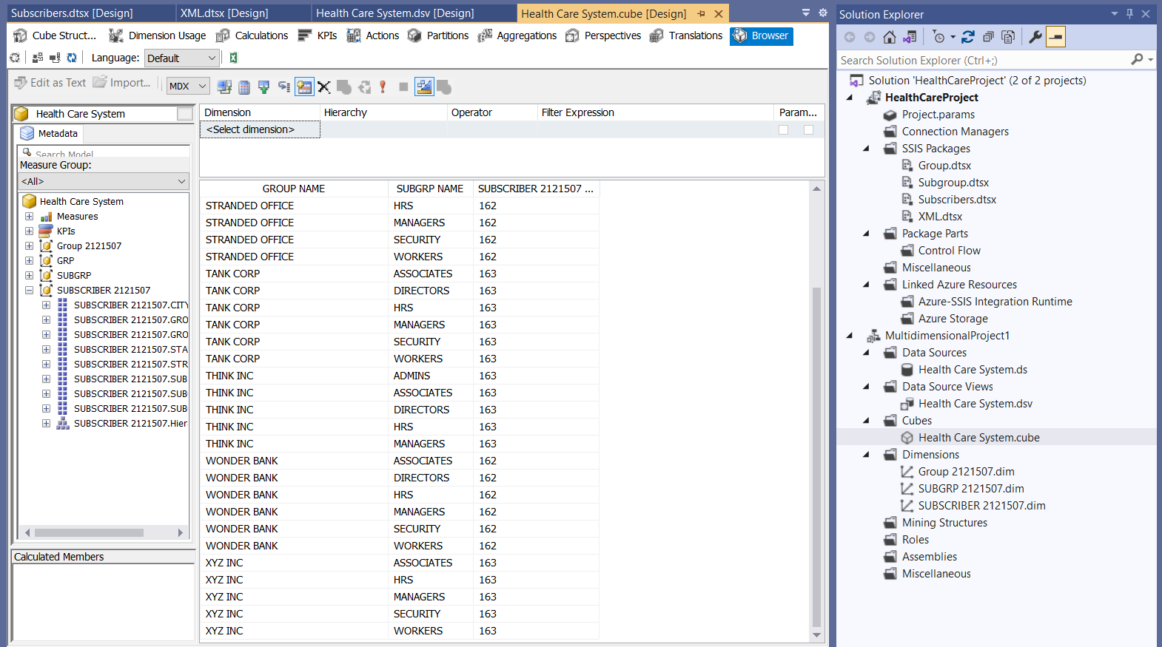
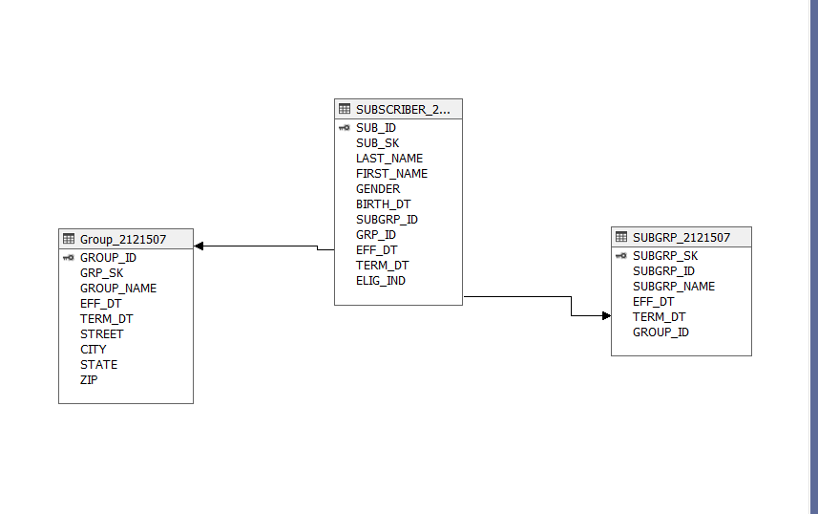
SSAS Implementation
SSAS Cube
Data source views

Slide 22
Optimizations & efficiency
Followed all the best practices for writing queries in SSMS like, the use of Clustered indexes.
Kept Is sorted = True, This is used to sort the data
Sort Transformation: It is mainly used here to remove duplicates.
Only one Conditional Split is used for different types of validations.
In the Derived column, the column is replaced not added as a new column, which saves memory and reduces complexity during transformation
In lookup Transformation, we used the Full Cache method due to less amount of data. For a scalable project, we need to the use No Cache Method.

Slide 23
conclusion
We have successfully performed ETL (Extract, Transform, and Load) on the given tables namely Group_comma.csv, Group_fixed.txt, Subgrp_tab.txt, Subscriber_comma.csv, and successfully generated a Welcome letter for each Subscriber in XML format.
There are different types of Transformations that have been used to make the data according to the required standard. Some transformations are- merge, sort, derived column, conditional split, etc.

Slide 24


